Slide 1
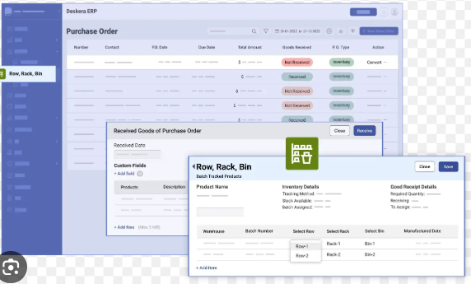
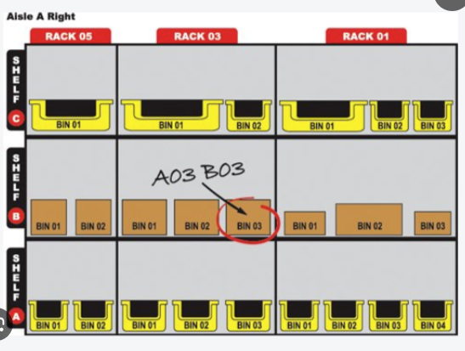
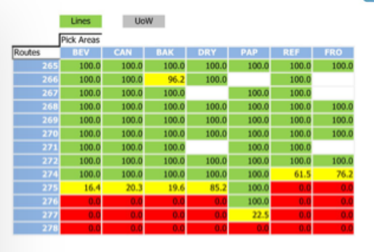
ERP SYSTEM
Front layout display
STM
SMT
SG Stator
Rotor
Stator
Machine shop
Pulser
Line
Sys Winding –I
Sys Winding –II
Testing machine
Cutting machine
Location display
Tools
Machine spare
24V relay
Volt meter
PLC
Power supply
Remove
Add
Remove quantity
Add
Remove
Add quantity
Qty status
remove quantity master list and popup message
Add quantity master list

